Slide 1

Making a Screencast
Akshar Prabhu Desai
ERTS Lab, IIT Bombay

Slide 2
Requirements
Download Camstudio from
http://www.camstudio.org/CamStudio20.exe
Use headphones with micro-phone
Keep your machine’s speakers off.

Slide 3
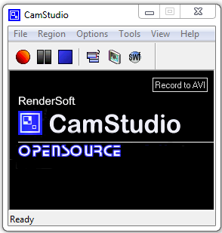
Using Camstudio

Slide 4
Instructions I
The first frame of your video should be the template provided to you mentioning your project title and you names.
Do not speak impromptu.
Make a transcript of what you are going to speak and submit that with the video as well.

Slide 5
Instructions II
We need following things in the video
How to install the additional software you are using. (excluding Matlab and AVR studio)
How to setup and configure your code.
You should start by showing the zipped file you submitted on moodle.
Since this is a screen cast you can show only those parts of setup which are to be done on PC
It will be good if you add some photographs of the bot and arena to the template we have provided.

Slide 6
Thanks

